Slide 1
Progress Report
Basis Technology
Kratika Agrawal, Vandana Anand, Xinlu He, Min Huang, Soumya Joshi, Jing Yu

Slide 2
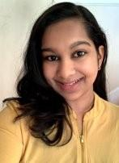
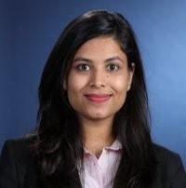




Project Team Introduction
Sponsors & Mentors
Gil Irizarry Kfir Bar
Vice President - Engineering Chief Scientist
gil@basistech.com kfir@basistech.com
Team Members
Vandana Anand vanand@wpi.edu 978-427-5212 | Kratika Agrawal kagrawal@wpi.edu 774-701-9288 | Jing Yu jyu5@wpi.edu 608-886-8578 | Soumya Joshi sjoshi2@wpi.edu 508-615-8354 | Min Huang mhuang3@wpi.edu 774-253-5410 | Xinlu He xhe4@wpi.edu 774-253-8221

Slide 3
Previous weeks’ accomplishments
Latent Relations Model
Trained the latent model with different sizes of bt docs
Tested the latent model
End to End Model
Preprocessing AIDA dataset and BT data
Training/Testing AIDA dataset as well as training other datasets (ex. Wikipedia)
Understanding/researching how to integrate BT data into the model
DeepType Model
Tried running DeepType Model with two approaches, but couldn’t accomplish
Robust Disambiguation
Understand the technique used for the disambiguation.

Slide 4

Project Goal
Goal: Improve BT’s current entity linking tool Rosette by applying a novel model to increase entity linking performance.
Current Stage: Implement three entity linking models based on research papers.
Notes:
Rosette is a text analytics tool used to extract entities from large amounts of text, specifically nouns such as a person, place, time, etc

Slide 5
Latent Relations Model

Slide 6
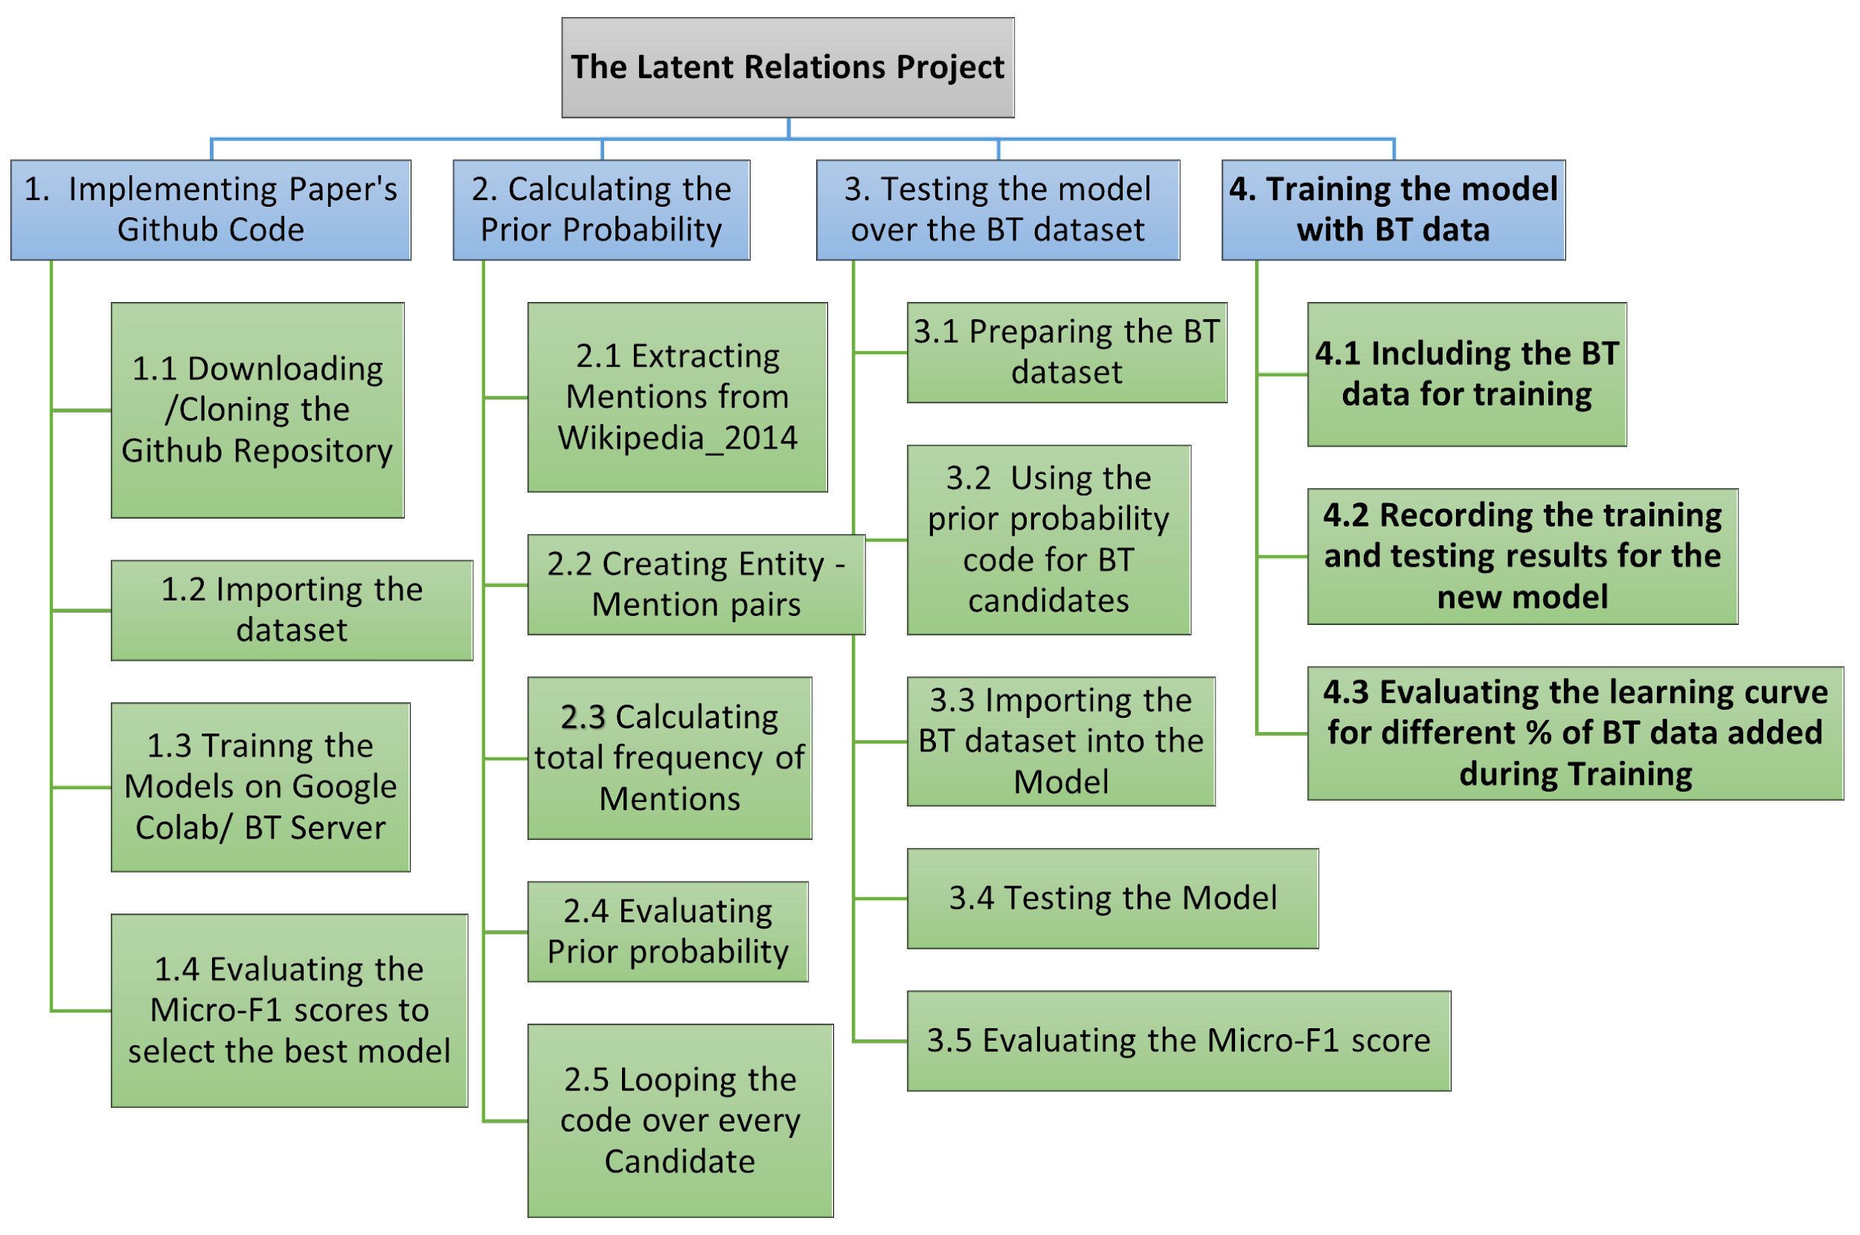
Work Breakdown Structure - Completed
* The 4th activity of the WBS was changed from expansion of current model to training the model using BT data. This change was suggested by the mentors.

Slide 7
Training with BT data
Final BT dataset: 70docs ( 60docs for training, 10docs for testing)
Training dataset:
Original AIDA dataset ( 953docs)
Original AIDA + BT 10docs
Original AIDA + BT 20docs
Original AIDA + BT 30docs
Original AIDA + BT 40docs
Original AIDA + BT 50docs
Original AIDA + BT 60docs

Slide 8
Training with BT data
Testing results:
Training docs | Original | Original+ 10docs | Original+ 20docs | Original+ 30docs | Original+ 40docs | Original+ 50docs | Original+ 60docs
Testing1 Results | 0.444 | 0.426 | 0.479 | 0.489 | 0.546 | 0.482 | 0.584
Testing 2 Results | 0.440 | 0.507 | 0.482 | 0.461 | 0.553 | 0.542 | 0.528
Testing 3 Results | 0.465 | 0.454 | 0.419 | 0.486 | 0.465 | 0.493 | 0.542
Avg Testing Results | 0.449 | 0.462 | 0.460 | 0.479 | 0.521 | 0.506 | 0.551

Slide 9
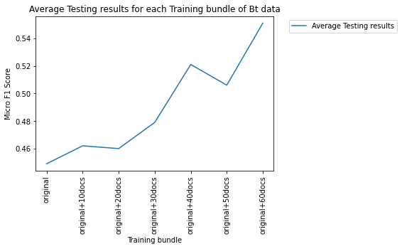
Learning Curve

Slide 10
End2End Model
Notes:
The End to End model includes Mention Detection(MD) and Entity Disambiguation(ED)

Slide 11
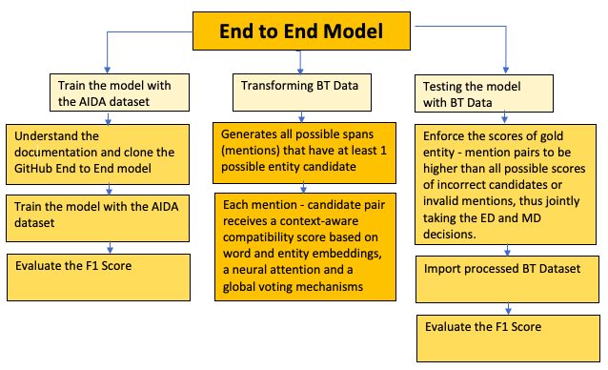
Workflow
✓
✓

Slide 12
End to End Model
Done
Preprocessing AIDA dataset and the BT data
Training/Testing AIDA dataset as well as training other datasets (ex. Wikipedia)
Comparing scores among other models
In Progress
Testing BT dataset
Next Step
Address challenges and research ways to integrate the BT dataset into the model

Slide 13
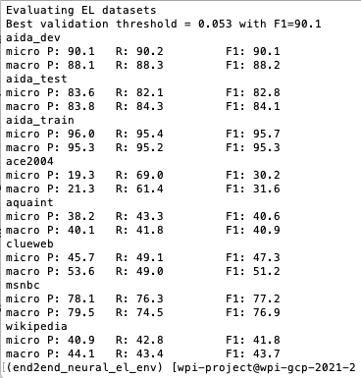
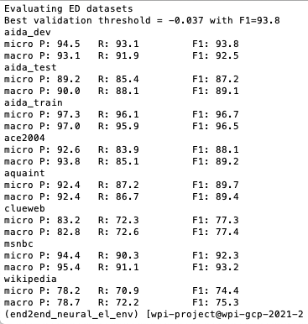
Training
Entity Linking Training
Entity Disambiguation Training
Model
Performance
Notes:
ED performed a lot better than EL especially for the Wikipedia dataset
The training model on different datasets for both EL and ED performed a bit worse overall than the latent model whose wiki training was the lowest performing dataset at 77%. However here, the Wiki dataset is at 74-75% which is lower.
Micro/Macro - For EL, these metrics are computed both in the strong matching and weak matching settings. Micro requires exactly predicting the gold mention boundaries and their entity annotations, whereas Macro gives a perfect score to spans that just overlap with the gold mentions and are linked to the correct gold entities.

Slide 14
Training/Testing AIDA
Entity Disambiguation | Train Score | Test Score | Test Precision | Test Recall
Best Scores | 92.2% | 85.7% | 88.5% | 83%
Entity Linking | Train Score | Test Score | Test Precision | Test Recall
Best Scores | 62.9% | 56.8% | 57.5% | 56.1%
Using all Spans Best Score | 89.1% | 80.1% | 83.5% | 76.9%
Notes:
While processing the BT dataset, we trained and tested the AIDA data to see what we could expect. We used the base model for EL and ED training/testing on the AIDA dataset which ran overnight and obtained these scores. We expect to see similar or lower scores for the BT dataset because it will be smaller. The AIDA dataset has more than 502K data points.

Slide 15
Implement with BT’s Data
Steps:
transform BT’s data into input format
choose candidates, create the universe as the wiki id of all the mentions and entity candidates, in all training and testing datasets
use the pre-trained Word2Vec files to find the relevant embeddings for the universe (using googlenews vectors file)
transfer the files into the tfrecords file for the model (tf.train.SequenceExample)
use the model trained with Aida dataset to test the model

Slide 16
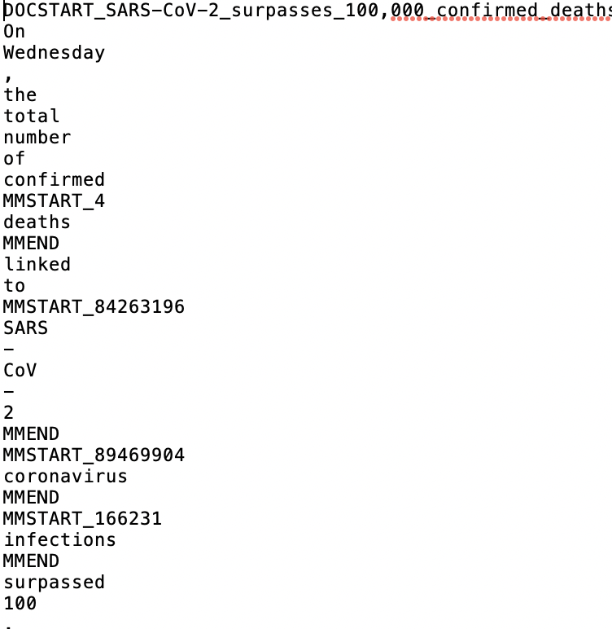
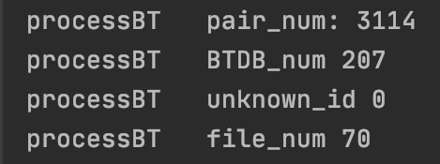
Implementation-Step 1:BT data processing
Doc start: DOCSTART_fileName
row: word or punc
mention: start with “MMSTART_Wikiid”
end with “MMEND”
between paragraph: *NL*

Slide 17
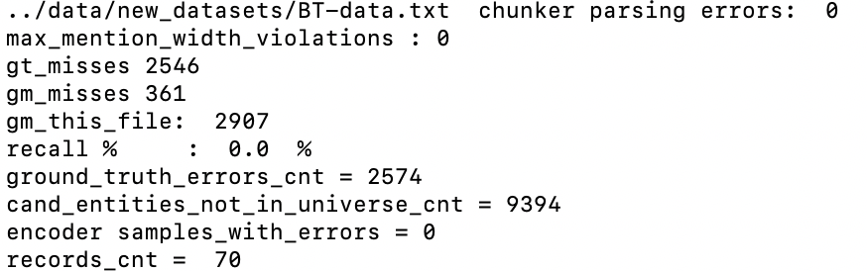
Implementation-Step 234
choose candidates, create the universe as the wiki id of all the mentions and entity candidates, in all training and testing datasets❌
use the pre-trained Word2Vec files to find the relevant embeddings for the universe (using googlenews vectors file) ✓
transfer the files into the tfrecords file for the model (tf.train.SequenceExample) ✓
problem:
using candidate group chosen by ourselves(probabilistic mention - entity map p(e|m),wikipedia 2014)
plug it into the process
Gt_misses: the ground truth entity is not in the entity candidate
Gm -> check if the gold mentions are not inside the candidates span

Slide 18
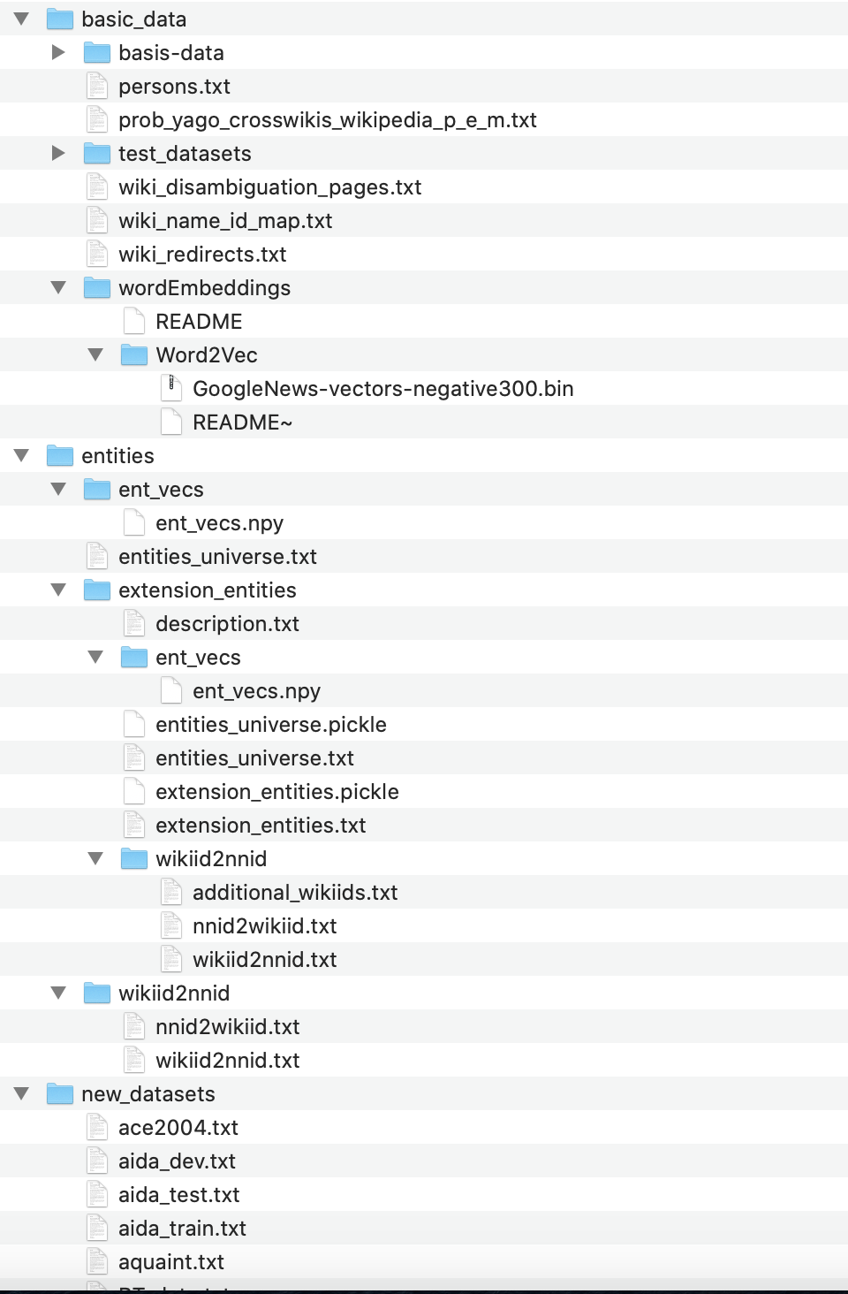
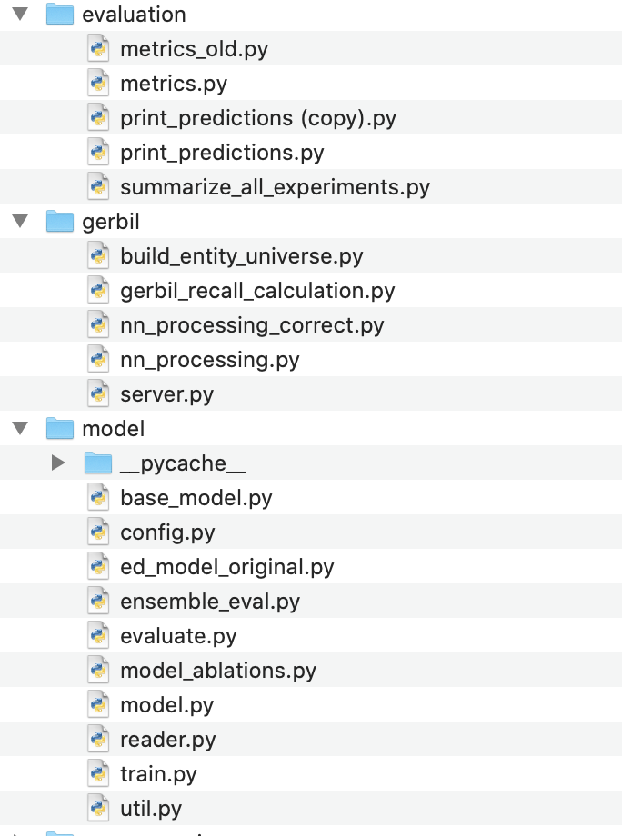
Implementation-Problem
This code:
targeting the purpose of the paper for the available datasets, with wikipedia concepts
was not designed with a plug and play mentality
data dictionary:
where to put candidate file
googlenews

Slide 19
Novel Disambiguation

Slide 20
Development Phases:
Get nodes and edges from generated Graph
Translate Graph Information to build Adjacency matrices
Generate embeddings for Mentions & Candidate Entities
Disambiguate entities multi-output classification
Build CNN architecture to learn various features
Combine Adjacency Matrices & Embeddings to input to CNN

Slide 21
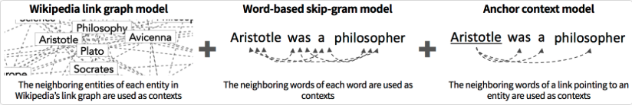
Wikipedia2Vec Embedding Model:
A tool for learning embeddings of words and entities from wikipedia
for each mention: get the word embedding
for each candidate entity: get the entity embedding
by jointly optimizing the following three submodels
Usage: Entity linking/ Named entity recognition/ Question answering/ Relation classification, etc.

Slide 22
Developing Adjacency Matrices:
Step 1: Developing Graph
Done:
Use Robust Disambiguation technique code to produce graph
https://github.com/codepie/aida
Extract Mention Nodes, Entity Nodes and edge information from the generated graph
Downloaded Yago dumps in tsv format
Installed Postgres
In Progress:
Running Script to load Yago dumps in Postgres to create data tables
Command:
D:\Postgres\bin\psql.exe -a -d postgres -h localhost -U postgres -f yago_postgres_infofoxes.sql
Step 2: Translating Graph to Matrices
Details in next slides

Slide 23
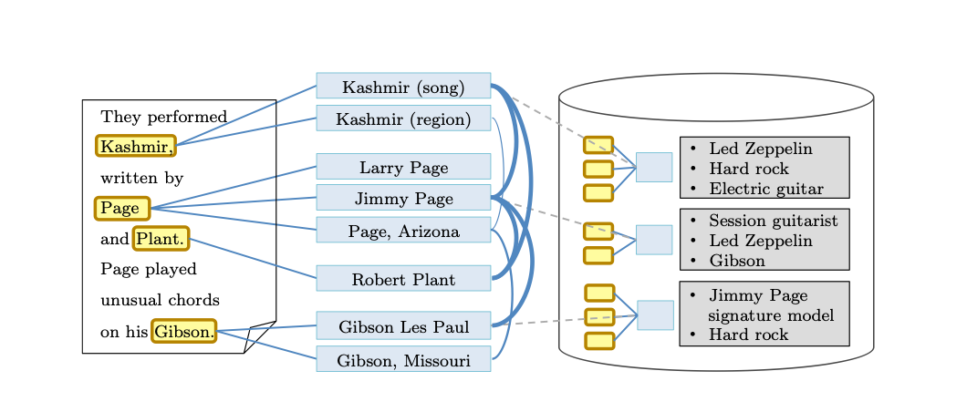
Adjacency Matrices:
Starting from a simplified version
e.g.

Slide 24
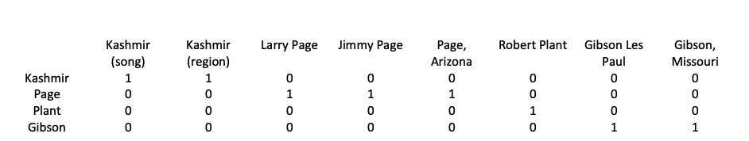
Adjacency Matrices:
Starting from a simplified version
e.g.
Mention-Entity Adjacency Matrix:

Slide 25
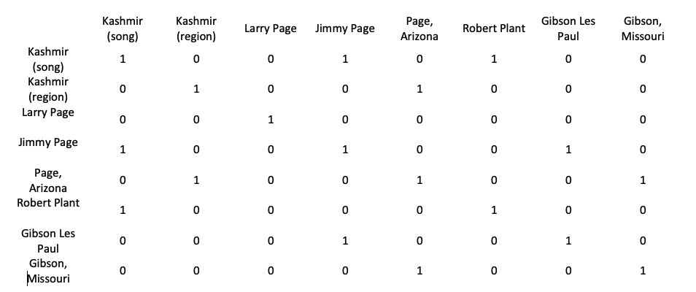
Adjacency Matrices:
Starting from a simplified version
e.g.
Entity-Entity Adjacency Matrix:

Slide 26
CNN Model:
CNN Input generation Steps:
Create Mention-Entity Adjacency Matrix (adj_me) & Entity-Entity Adjacency Matrix (adj_ee) for few documents, save as npy
Download Wikipedia2Vec embeddings, load & get embeddings for all mentions (emb_m) & entities (emb_e)
Create Input for the model as follows:
emb_m * adj_me * emb_e
emb_e * adj_ee * emb_e
CNN Architecture:
CNN architecture with Convolution layers, Relu and Pooling.
Consider multi-mention entity disambiguation as Multi-Object Classification problem
Let, m = number of mentions in a text document
e_{m} = number of candidate entities per mention (5 for Constrained graph development)
Split the CNN at the end to have m fully connected networks, each with e_{m} end nodes
Use Softmax to disambiguate among various entities for each mention

Slide 27
Difficulties
Large data files and not enough space
Issue testing End-to-End model on BT dataset
Issue running DeepType model
Combining embeddings and adjacency matrices
Generating graphs dynamically from Aida repository code

Slide 28
Contribution
Soumya | Testing the latent model Workflow Summary
Min | Generating the final BT dataset Training the latent model with different sizes of BT dataset Testing the latent model
Vandana | Training/Testing End to End Model Workflow Diagram
Xinlu | Transforming BT’s data to format used in End2End code Testing BT Data
Kratika | Importing Yago dataset to Postgres Running aida repository for generating graphs Building CNN model
Jing | Generating embeddings for mentions & entities Building CNN model

Slide 29
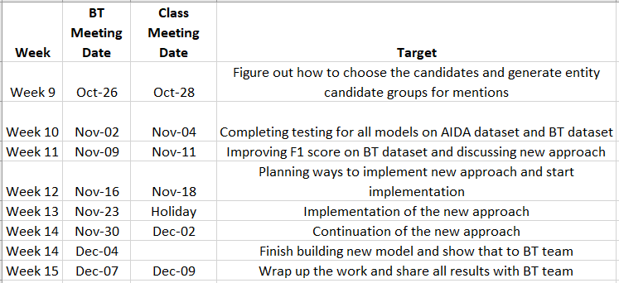
Plans
Implementation Timeline
Notes:
in the upcoming weeks we will implement the final models for the company’s dataset and see if we can get a better micro f1 score

Slide 30
Thank you!
Any Questions?

